Slide 1
Purpose & use of this presentation
The purpose of this presentation is to provide a consistent template to our institutional representatives in presenting Ethics Awareness Week to senior leadership at their institutions.
Use this presentation to present your planning committee, your proposed Ethics Awareness Week activities and the resources you may need. In addition, we have provided ideas for how senior leadership can be engaged during the campaign.
This is a template – so slides 7, 16, 17, 18 and 19 have areas for you to insert information, from your institutional name/logos to your proposed activities. Please update these slides before presenting this information. In addition, please delete this informational slide from any final presentations.
THANK YOU for serving as an Ethics Awareness Week institutional representative. Your leadership is vital to the success of the campaign and in continuing to strengthen our ethical culture across the USG.

Slide 3
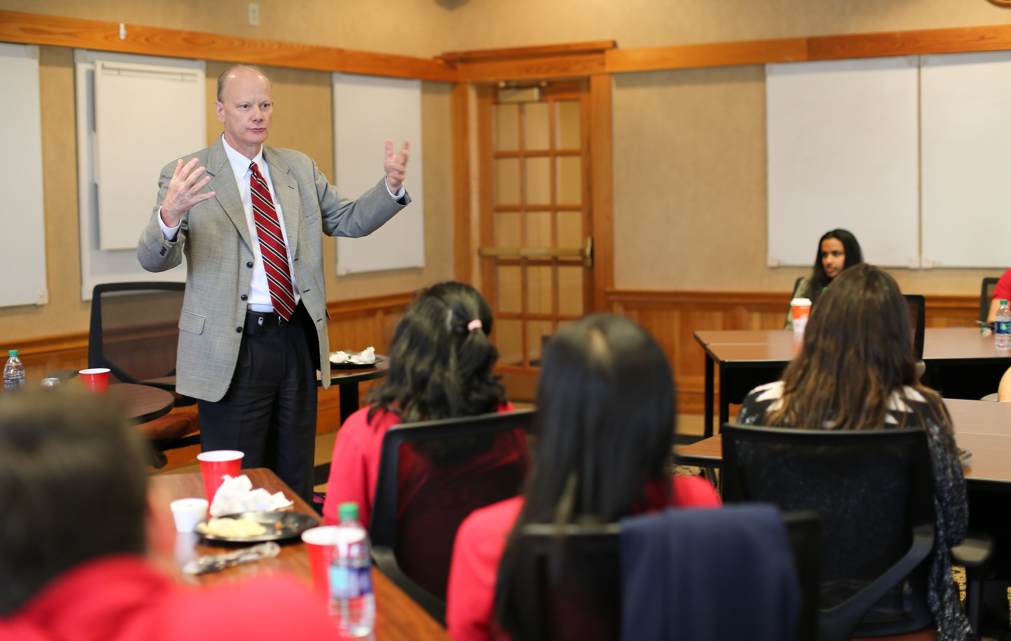
INTEGRITY
We will be honest, fair, impartial and unbiased in our
dealings both with and on behalf of the USG.

Slide 4
EXCELLENCE
We will perform our duties to foster a culture of excellence and high quality in everything we do.

Slide 5
ACCOUNTABILITY
We firmly believe that education in the form of scholarship, research, teaching, service and developing others is a public trust. We will live up to this trust through safeguarding our resources and being good stewards of the human, intellectual, physical and fiscal resources given to our care.

Slide 6
RESPECT
We recognize the inherent dignity and rights of every person, and we will do our utmost to fulfill our resulting responsibility to treat each person with fairness, compassion and decency.

Slide 7
Presenters Name Presenters Title Institution Name
[INSERT YOUR INSTITUTIONAL NAME/LOGO HERE]
What is Ethics Awareness Week and how should Leadership Engage?

Slide 8
Ethics Awareness Week Nov. 9-15, 2020
A message to leadership. In the 2020 Ethics Awareness Week letter to the USG Presidents, Chancellor Wrigley spoke to our shared core values and code of conduct being incorporated into our day-to-day decision making.
He stated, “Now more than ever, we must continue to demonstrate ethical leadership as we advance our priorities of degree attainment, affordability and efficiency.”

Slide 9
AUGUST 2020
PLANNING KICKOFF
Planning for 2020 Ethics Awareness Week kick-off was in August. There are representatives from all 26 USG institutions working alongside the System Office in coordination.
NOVEMBER 2020
IMPLEMENTATION
Implementation of ethics awareness and the USG core values is an everyday, all year initiative. However, we highlight and celebrate our ethical culture annually during Ethics Awareness Week, Nov. 9-15, 2020.
DECEMBER 2020-AUGUST 2021
REFLECTION
At the end of each year, each institution provides a final report on activities, etc. around ethics awareness and ethical culture. These reports assist in best practices and planning for the next year.

Slide 10
BEST PRACTICES
VALUES INTEGRATION
For the institutions to examine how their core values, and those of the USG, integrate within their strategic plans.
TRAINING & PRESENTATIONS
Ethics Training and Presentations to make ethics and values a part of the conversation is a good practice throughout the year.
SURVEYS AND FEEDBACK
Hearing your employees voice is important. Making sure there are opportunities for feedback to leadership is key.
BEST PRACTICES
WEBSITE, VIDEOS AND SIGNAGE
LEADER LED
Be intentional to make the values and your ethical culture “visible” to employees and students.
The Senior Leadership must lead the way, through communication and by example through action.

Slide 11
Ethics Awareness Week = Opportunity

Slide 12
Opportunity #1: Are we, as a USG institution, promoting the Ethics and Compliance program?
Ethics Awareness Week = Opportunity
USG Ethics Policy Promotion & Review
Promotion of the USG Core Values & our Institutional Values
Conducting Onboarding & Orientation Ethics Trainings
Employee Ethics Refresher Trainings
Proactive Compliance Reviews
Promotion and Access to the Ethics Reporting Line

Slide 13
Ethics Awareness Week = Opportunity
Opportunity #2: Are we celebrating and promoting our ethical culture all year, highlighting it during Ethics Awareness Week?
If we are promoting the Ethics and Compliance program all year, we can celebrate this week through:
Events: bringing students, faculty, staff, alumni and our community together
Trainings: making sure all students, faculty, staff, alumni, etc. have had proper education around our ethics and culture
Awards: Celebrate the ambassadors to strengthen your culture (students, employees, units, etc.)

Slide 14
Ethics Awareness Week = Opportunity
Opportunity #3: Are our leaders visible and engaged across our institution?
“Leaders” are defined many ways, for example:
Senior Leadership: is the Cabinet engaged, visible and communicating the importance of ethical leadership?
Faculty Leadership: is Faculty Senate and the departments within Academic Affairs showing engagement with and promotion of ethics?
Staff Leadership: is Staff Council engaging and promoting ethics?
Student Leadership: are the student organizations/leaders talking to the values and promoting the ethics of the institution?

Slide 15
Ethics Awareness Week at [INSERT INSTITUTION]

Slide 16
PROPOSED PLANNING TEAM
Ethics Awareness Week at [INSERT INSTITUTION NAME]
Insert Here the employees who you think should be on your institutional planning team
Name
Name
Name
Name

Slide 17
Ethics Awareness Week at [INSERT INSTITUTION NAME]
PROPOSED ACTIVITIES
Insert here information around the different activities you are proposing for your institution.
Example
Example
Example
Example
Example

Slide 18
Ethics Awareness Week at [INSERT INSTITUTION NAME]
PROPOSED RESOURCES
Insert here a list of the high-level resources you need to support these activities.
Budget (amount listed)
Key partners (if any)
Senior leaders engagement (dates/times)
Video creation, etc.

Slide 19
Ethics Awareness Week Timeline
Create a timeline to present to Senior Leadership.
Example
Ethics Awareness Week Nov. 9-15, 2020
Monday (9th) – University EAW Kick-off Luncheon (student, faculty, staff, administrative and community leaders)
-institutional digital/social media campaign on value: integrity
-ethics trivia email (Question 1) to all employees
Tuesday (10th) – University Ethics Training (USG Ethics Training facilitated to all employees by direct supervisors)
-institutional digital/social media campaign on value: excellence
-ethics trivia email (Question 2) to all employees
Wednesday (11th) – Email video message from the President to all students/employees on ethical leadership and the promotion of an ethical culture

Slide 20
What can Senior Leaders do to be engaged?
Talk about it. Both Ethics Awareness Week and the System and institutional values
Recognize it. Look for an opportunity to highlight employees who exhibit our values
Attend. Be visible and engaged within the Ethics Awareness Week activities.
Lead. Host an event with your direct reports and/or leaders across the institution.

