Slide 1
Best Practices in Substance Use Disorders: The Importance of Integrated Care
Elinore F. McCance-Katz, MD, PhD
Assistant Secretary for Mental Health and Substance Use
Substance Abuse and Mental Health Services Administration
U.S. Department of Health and Human Services
ASAP, Niagara Falls, NY
September 23, 2019

Slide 2
Overview
Epidemiology of substance use and mental disorders in the United States
  High rates of co-occurring disorders
Best practice in clinical treatment of SUDs
  Addressing polysubstance use
  Addressing co-occurring mental disorders
Clinical settings and care integration
  Specialty SUD programs
    E.g.: Centers of Excellence for Treatment of OUD
  CCBHC models
  FQHC/primary care models
SAMHSA resources
  Addressing the opioids epidemic
  Block grant funds
  Technical assistance and training programs: CIHS and others

Slide 3
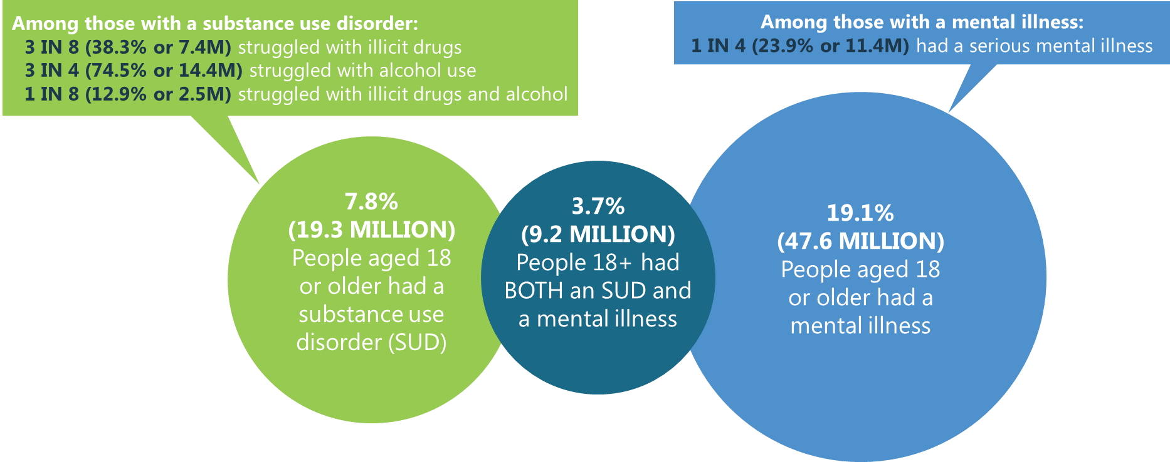
Mental Illness and Substance Use Disorders in America
PAST YEAR, 2018 NSDUH, 18+
In 2018, 57.8M Americans had a mental and/or substance use disorder.

Slide 4
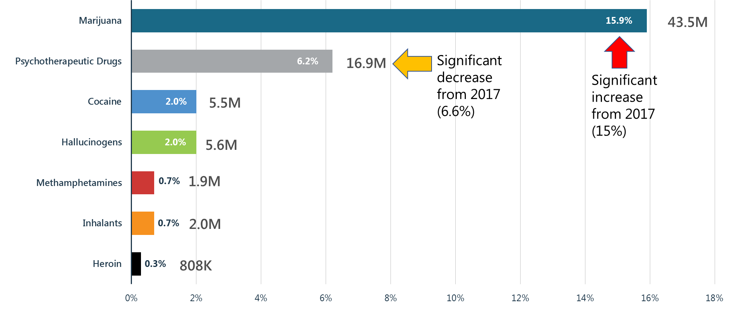
Illicit Drug Use: Marijuana Most Used Drug
PAST YEAR, 2018 NSDUH, 12+

Slide 5
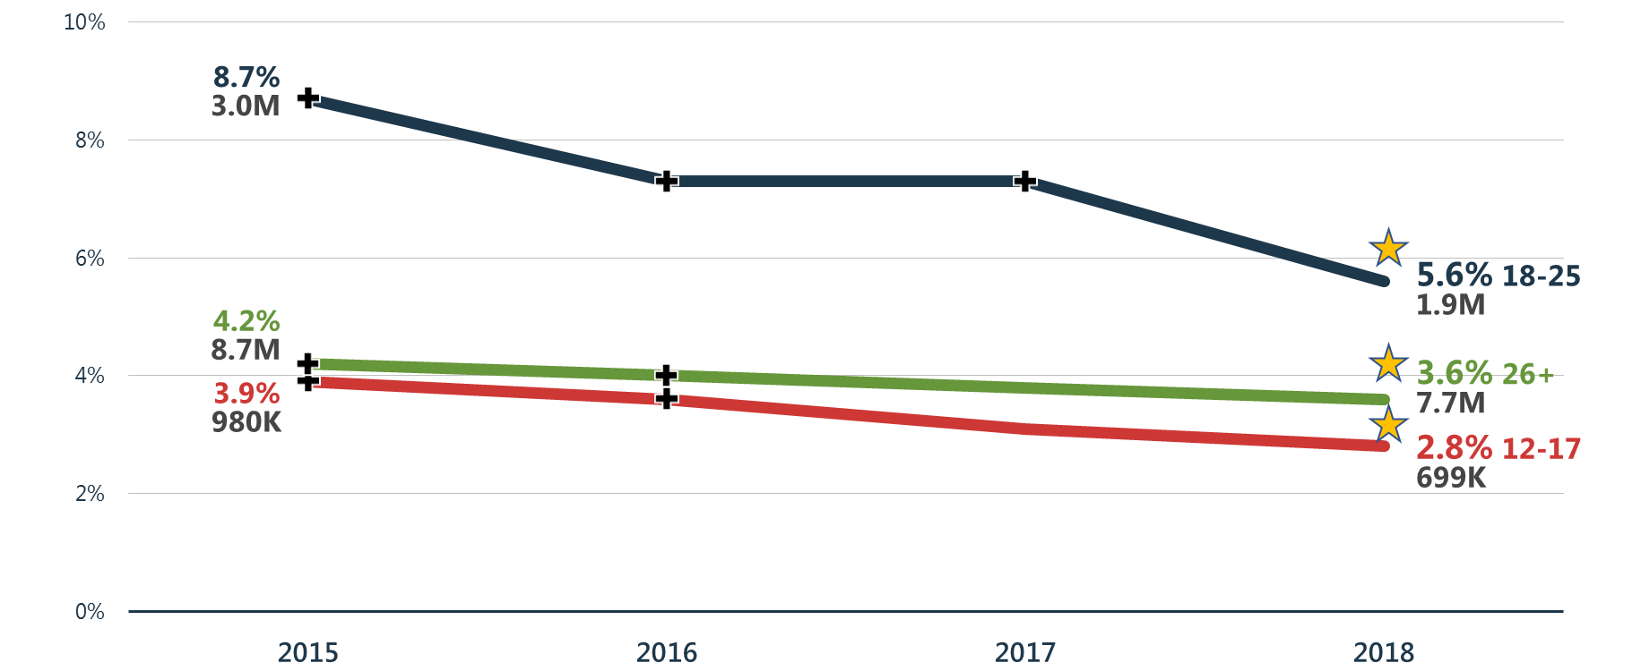
Opioid Misuse
PAST YEAR, 2015-2018 NSDUH, 12+
+ Difference between this estimate and the 2018 estimate is statistically significant at the .05 level.

Slide 6
Prescription Pain Reliever Misuse and Heroin Use
PAST YEAR, 2015-2018 NSDUH, 12+
1M
+ Difference between this estimate and the 2018 estimate is statistically significant at the .05 level.

Slide 7
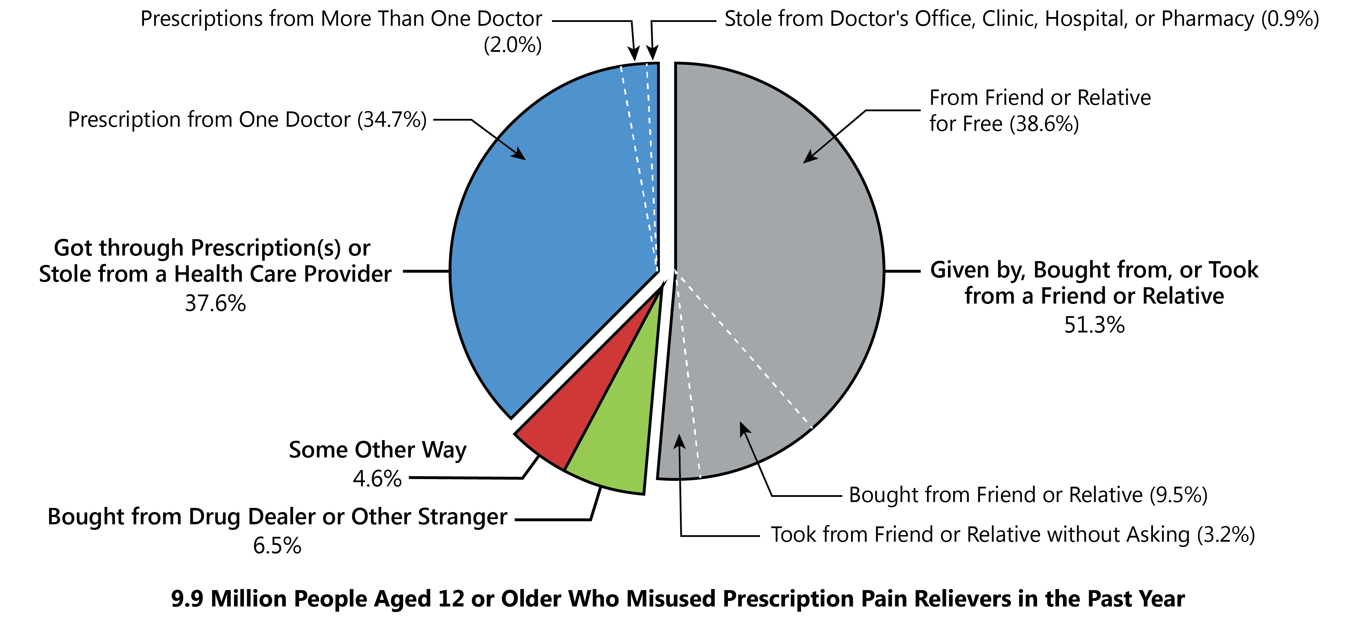
Sources Where Pain Relievers Were Obtained for Most Recent Misuse among People Who Misused Prescription Pain Relievers
PAST YEAR, 2018 NSDUH, 12+
83.2% of the friends or relatives were prescribed the pain reliever by a single doctor
Notes:
AS-8
SOURCE: See forthcoming 2018 Detailed Table 6.5 for more information.

Slide 8
Treatment Gains: Number of Individuals Receiving Pharmacotherapy for Opioid Use Disorder (MAT)

Slide 9
Alcohol Use in the United States: 2018
PAST MONTH, 2018 NSDUH, 12+
139.8 Million
Current Alcohol Users
67.1 Million
Binge Alcohol Users
(48.0% of Alcohol Users)
16.6 Million
Heavy Alcohol Users
24.7% of Binge Alcohol Users are Heavy Users
11.8% of Alcohol Users are Heavy Users
Notes:
Slide ID: FFR1.06
SOURCE: See Figure 6 in the forthcoming 2018 NSDUH Report for more information.

Slide 10
Marijuana Use
PAST MONTH, 2015-2018 NSDUH, 12+
+ Difference between this estimate and the 2018 estimate is statistically significant at the .05 level.

Slide 11
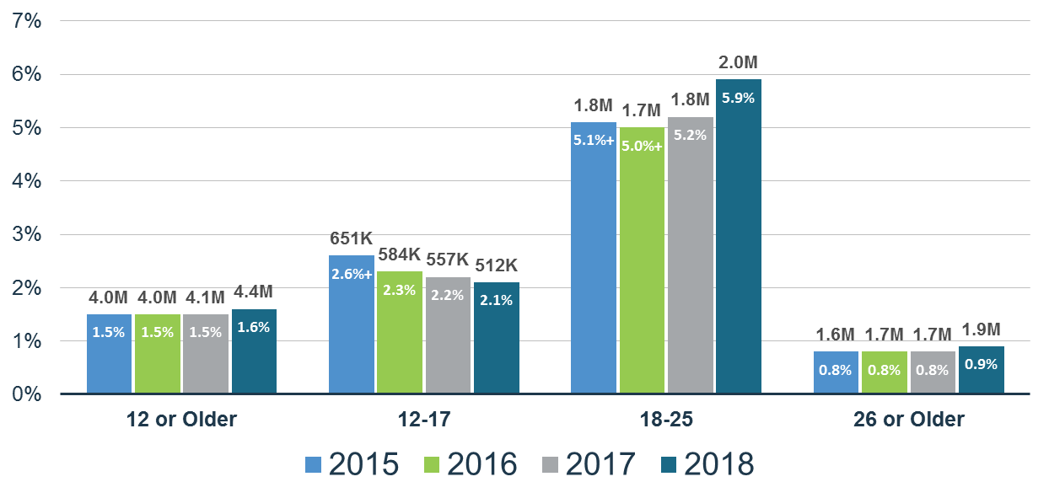
Marijuana Use Disorder
PAST YEAR, 2015-2018 NSDUH, 12+
+ Difference between this estimate and the 2018 estimate is statistically significant at the .05 level.
Notes:
Slide ID: FFR1.39
SOURCE: See figure 39 in the forthcoming 2018 NSDUH Report for more information.

Slide 12
Methamphetamine Use: Significant Increase in Adults > 26 y.o.
PAST YEAR, 2015-2018 NSDUH, 12+
+ Difference between this estimate and the 2018 estimate is statistically significant at the .05 level.

Slide 13
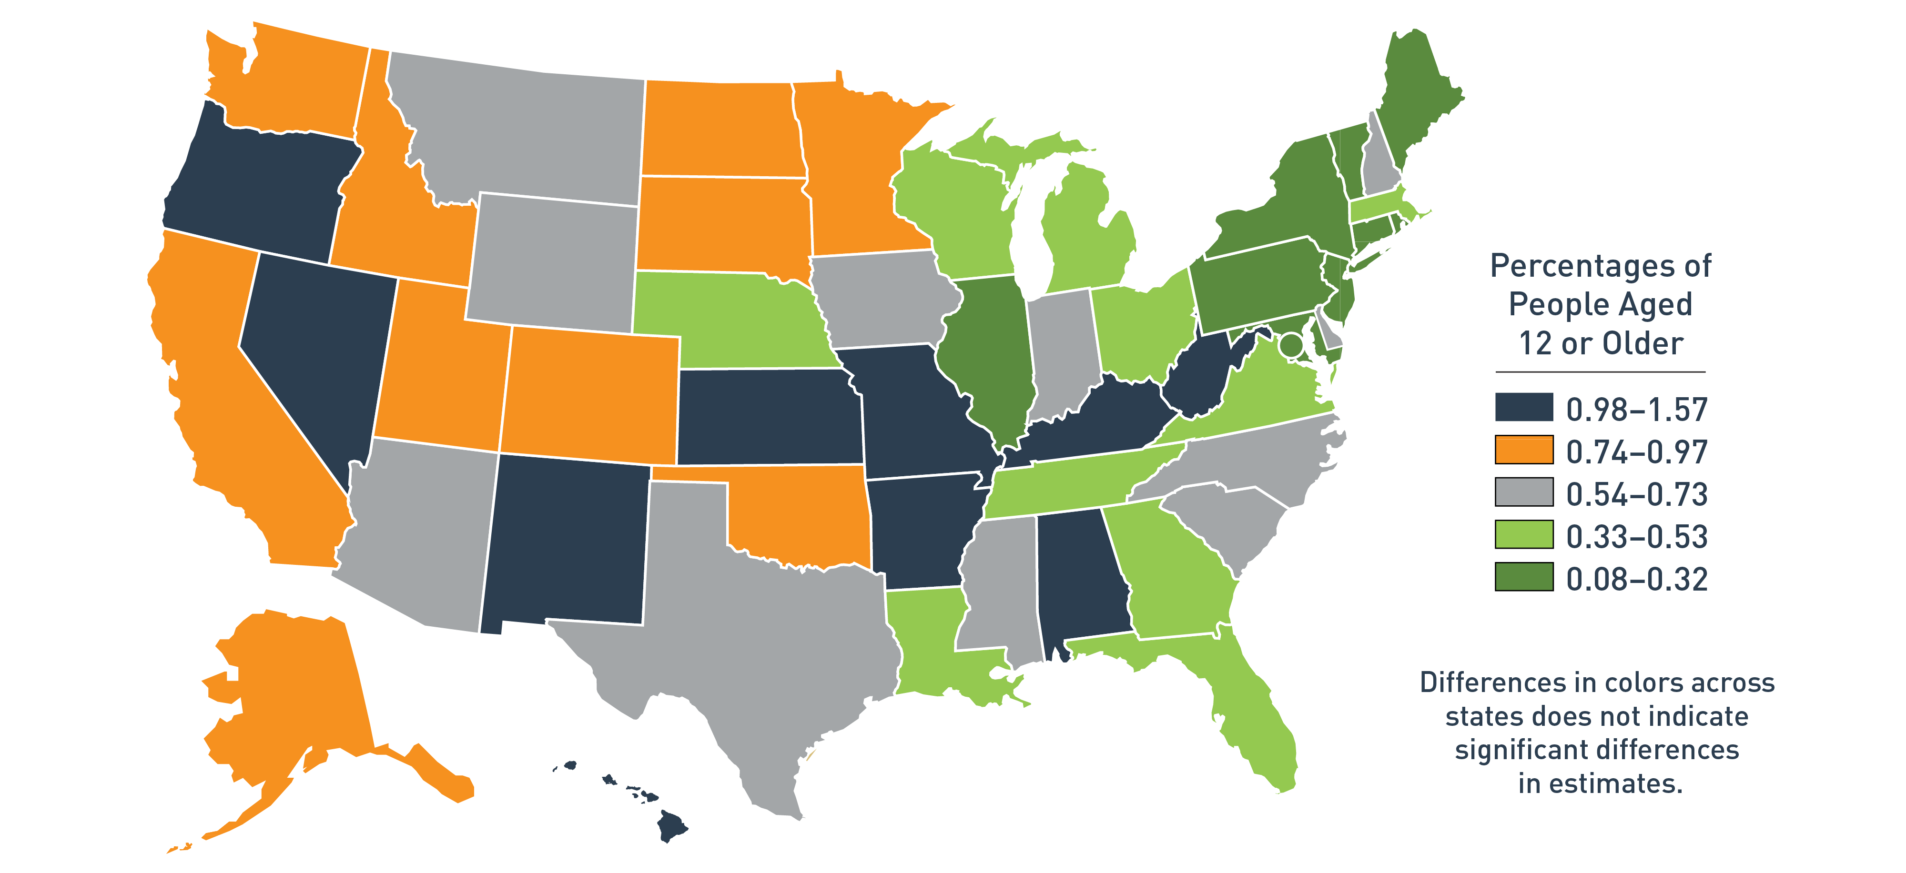
Methamphetamine Use by State
PAST YEAR, 2016-2017, 12+
Source: NSDUHs, 2016 and 2017.
Notes:
Can this be updated to 2017? Can we get a similar map for cocaine use? Please add.
CBHSQ response:
Updated this map for past year methamphetamine use based on 2016-2017 data
Added a new map for past year cocaine use by state based on 2016-2017 data (new slide #10).

Slide 14
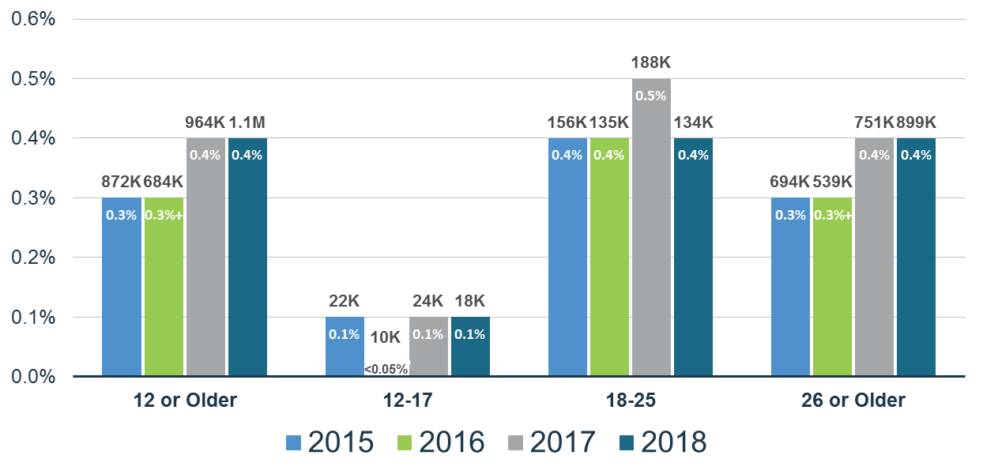
Methamphetamine Use Disorder
PAST YEAR, 2015-2018 NSDUH, 12+
+ Difference between this estimate and the 2018 estimate is statistically significant at the .05 level.

Slide 15
Cocaine Use: Significant Decline among Young Adults (18-25 y.o.)
PAST MONTH, 2015-2018 NSDUH, 12+
+ Difference between this estimate and the 2018 estimate is statistically significant at the .05 level.

Slide 16
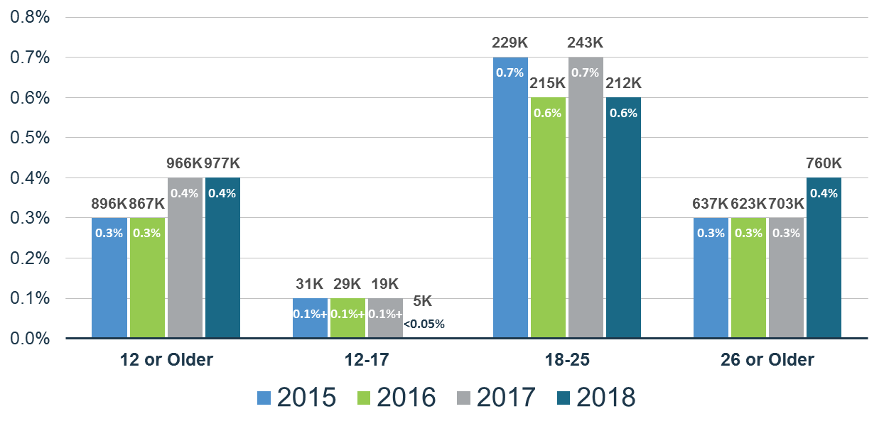
Cocaine Use Disorder
PAST YEAR, 2015-2018 NSDUH, 12+
+ Difference between this estimate and the 2018 estimate is statistically significant at the .05 level.
Notes:
Slide ID: FFR1.40
SOURCE: See figure 40 in the forthcoming 2018 NSDUH Report for more information.

Slide 17
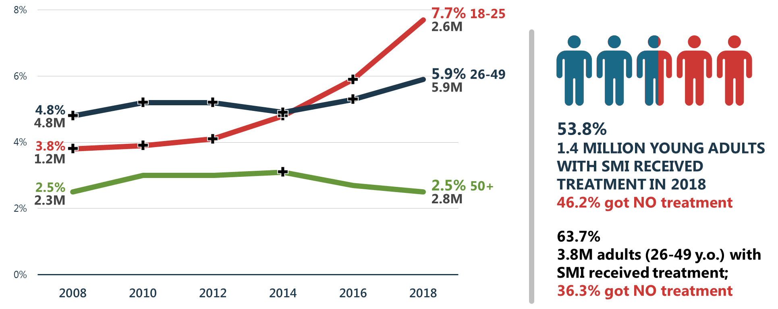
Serious Mental Illness (SMI) Rising among Young Adults (18-25 y.o.) and Adults (26-49 y.o.)
PAST YEAR, 2008-2018 NSDUH, 18+
+ Difference between this estimate and the 2018 estimate is statistically significant at the .05 level.

Slide 18
Major Depressive Episodes
PAST YEAR, 2015-2018 NSDUH, 12+
Note: The adult and youth MDE estimates are not directly comparable.
+ Difference between this estimate and the 2018 estimate is statistically significant at the .05 level.

Slide 19
Co-Occurring Issues: Substance Use Is More Frequent among Adults (>18 y.o.) with Mental Illness
PAST MONTH, 2018 NSDUH, 18+
+ Difference between this estimate and the estimate for adults without mental illness is statistically significant at the .05 level.

Slide 20
Co-Occurring Issues: Substance Use Is More Frequent among Adults (>18 y.o.) with Mental Illness
PAST YEAR, 2018 NSDUH, 18+
+ Difference between this estimate and the estimate for adults without mental illness is statistically significant at the .05 level.

Slide 21
Alcohol Use Related to Other Substance Use, MDE and SMI
PAST YEAR/MONTH, 2018 NSDUH, 12+
+ Difference between this estimate and the estimate for people with past month use but not heavy alcohol use is statistically significant at the .05 level.

Slide 22
Marijuana Use Related to Other Substance Use, MDE and SMI
PAST YEAR/MONTH, 2018 NSDUH, 12+
+ Difference between this estimate and the estimate for people with past year marijuana use is statistically significant at the .05 level.

Slide 23
Opioid Misuse Related to Other Substance Use, MDE and SMI
PAST YEAR/MONTH, 2018 NSDUH, 12+
+ Difference between this estimate and the estimate for people with past year opioid misuse is statistically significant at the .05 level.

Slide 24
Best Practices in the Treatment of Substance Use Disorders
Screen for hazardous substance use/misuse/abuse/use disorders
  SBIRT: USPSTF endorses screening for tobacco, alcohol, illicit drug use
  Refer for specialty treatment where indicated
Screen for mental health problems
These get at depression and suicidal thinking (PHQ-9)
Take a complete history of mental health, substance use, and physical health issues
Address all problems in treatment plan
  If a specialist is needed; make referral and get releases in place to facilitate collaborative, coordinated care for the patient

Slide 25
SBIRT: A Means of Improving Community Health
Current model of SBIRT based on IOM report recommending development of integrated service systems linking:
  community-based screening and brief intervention
  Assessment and referral activities
SBIRT: fills a gap between primary prevention and more intensive treatment for those with SUDs
SBIRT goal: to improve community health by reducing prevalence of adverse consequences of substance misuse including SUDs through early intervention and referral when needed

Slide 26
What is SBIRT in Practice?
Screening: quickly assess use and severity of alcohol, illicit drugs, and prescription drug abuse
Brief Intervention: a 3-5 minute motivational interview and awareness-raising intervention given to risky or problematic substance users
Referral to Treatment: referrals to specialty care for patients with substance use disorders

Slide 27
Screening
Ask about
  Alcohol use: drinks/d, drinks/wk,
    Binge drinking M:> 5/W > 4 drinks in approx. 2 hour time period
    Heavy drinking: binge use on 5 or more days in past month
  Use of prescription drugs for a non-medical reason/for a purpose not part of why prescribed
  Use of any illicit substance
  Symptoms of depression PHQ-9, PHQ-2
    Interest, pleasure, depressed mood, energy, appetite, concentration, guilt, motor activity, thoughts of hurting self
    PHQ-2: loss of interest/pleasure, depressed/hopeless
  Follow up on positive responses

Slide 28
Take a Complete History
People come to treatment with an identified drug to be addressed
Polysubstance abuse is the rule; not the exception
History is very important to treatment planning

Slide 29
Taking the History
History of drug use:
  Start with first substance used and age at first use
  Ask about all substances (licit and illicit)
  Determine changes in use over time (frequency, amount, route)
  Assess recent use (past several weeks)
Tolerance, intoxication, withdrawal:
  Explain what is meant by tolerance
  Determine the patient’s tolerance and withdrawal history
  Ask about complications associated with intoxication and withdrawal
Relapse/attempts to abstain:
  Determine if the patient has tried to abstain, and what happened
  Longest period of abstinence
  Identify triggers to relapse

Slide 30
Taking the History
Consequences of use:
  Determine current and past levels of functioning
  Identify consequences
      Medical
      Family
      Employment
      Legal
      Psychiatric
      Other
Craving and control:
  Ask about craving and/or a compulsive need to use
  Determine if patient sees loss of control over use
Treatment Episodes
  Response to treatment
  Length of abstinence
Medical history:
  Past and/or present:
    Significant medical illnesses
    Hospitalizations/Operations
    Accidents/injuries

Slide 31
Taking the History
Psychiatric history
  Symptoms/mental illnesses
  Type of treatment(s)
  Medication treatment
Family history:
  Substance use disorders
  Other psychiatric conditions
  Other medical disorders
Personal (or social) history:
  Birth and early development
  Education
  Employment and occupations
  Marital status and children
  Living situation
  Legal status

Slide 32
Universal Precautions
Toxicology screen: baseline and as clinically indicated
Check PDMP: baseline and regularly thereafter

Slide 33
Importance of Mental Health Assessment
Psychiatric considerations
  Suicidality
  Homicidality
  Psychosis (paranoia, hallucinations)
  Cognitive impairment or dementia (orientation, mood, affect, thought process/content, memory, abstraction, fund of knowledge, insight, judgment)

Slide 34
Co-Occurring Disorders
Distinguish between substance-induced disorders versus independent psychiatric disorders:
  Substance-induced: Disorders related to the use of psychoactive substance; typically resolve with sustained abstinence
  Independent: Disorders which present during times of abstinence; symptoms not related to use of psychoactive substance; will need psychiatric treatment

Slide 35
Substance-Induced Disorders
  Symptoms occur only when actively abusing drugs/alcohol
  Symptoms are related to intoxication, withdrawal, or other aspects of active use
  Onset and/or offset of symptoms are preceded by increases or decreases in substance use
  Goal:
    sustained abstinence
    re-evaluation

Slide 36
Independent Disorders
  Symptoms occur when not using psychoactive substances, or with steady use without change in amount or type
  Family history may point to independent disorder if present in first degree relatives
  Goal: cessation of substance use and treatment of psychiatric symptoms

Slide 37
Independent Mental Disorders that Co-occur with SUDs
Will respond to medication treatments for depressive and anxiety disorder(s) at similar rates to those without substance use disorders

Slide 38
Integrated Care
Diagnosis(es) and level of care determination:
Develop treatment plan that addresses all substance use and mental disorders: bring all necessary providers into the plan development; primary clinician, case manager, counselor, psychiatrist, medical provider
Determine if medications are needed; discuss with patient; shared decision-making; monitoring for effectiveness/side effects
Determine psychosocial treatments needed: counseling, psychoeducation, MI, CBT, CM, family therapy
Determine recovery supports needed: accessing benefits, vocational/educational assistance, childcare assistance, transportation, housing
Releases of information to allow communication between providers

Slide 39
Clinical Settings and Care Integration
  Specialty SUD programs
    E.g.: Centers of Excellence for Treatment of OUD
  Certified Community Behavioral Health Clinics (CCBHC) models
    Focus is on service to seriously mentally ill
    Integrated mental, substance use, physical healthcare
    24/7 crisis intervention services
  Community mental health centers
    Focus on addressing mental disorders
    Integration of substance use disorder treatment
  FQHC/primary care models/healthcare systems
    Based in medical settings
    Mental health and substance use care integrated

Slide 40
Importance of Provider Communication: Change to 42 CFR
Changes to redisclosure regulations to allow recording of substance use disorder treatment information in non-Part 2 medical records
Release to an entity (e.g.: SSA) with patient consent
Prescribers can check central registries; dispensed scheduled medications can be recorded in PDMP according to state law
Sharing of information by a Part 2 program in time of declared natural disaster
Change to sanitizing requirements
Research disclosures under Part 2 by HIPAA covered entity to entities not covered by HIPAA.
Extension of court-ordered placement of undercover agents/informants in course of investigation to 12 months

Slide 41
Strengthening Healthcare Practitioner Training and Education
New Approaches: Addressing Parity through Increased Provider Prep
Addressing Training Needs of Any Provider—not just Grantees
TTCs: MH with supplements for children’s issues, Substance Abuse Prevention,
Addiction TTCs, CSS-SMI, Privacy TTC, Eating Disorders TTC
PCSS Universities
State Targeted Response to Opioids (STR) TA program
Project ECHO type training programs, Centers of Excellence: Practical experience
Education on assessment/treatment of SUDs by healthcare profession
Evidence-Based Practices Website
SAMHSA Products (e.g.: TIP 63, Pregnant/Post Partum Women with
OUD Factsheets, NSDUH presentation, Prevention Day, MAT in jails/prisons)

Slide 42
Major Innovation: SAMHSA: Technical Assistance and Training
EVIDENCE-BASED, LOCAL TRAINING, NATION-WIDE SCOPE
Evidence-Based Practice Repository in NMHSUPL
National Technical Assistance/Training Centers:
State Targeted Response to Opioids, Providers’ Clinical Support System for Medication Assisted Treatment, Clinical Support System for Serious Mental Illness/Supplements for School-Based Mental Health Programs, National Child Traumatic Stress Network, National Center on Substance Abuse and Child Welfare, Center for Integrated Health Services, Veterans, GAINS (Criminal Justice), Disaster, Social Inclusion/Public Education, Suicide Prevention, SOAR, Privacy (HIPAA, 42 CFR), Eating Disorders
Combined Efforts at the State, Regional, and Local Levels Oriented to All Health Professionals
Regional Substance Abuse Prevention, Addiction, Mental Health, Collaborating Technology Transfer Centers
Region 1
Region 2
Region 3
Region 4
Region 5
Region 6
Region 7
Region 8
Region 9
Region 10
National Hispanic/Latino TTCs
National American Indian/Alaska Native TTCs

Slide 43
Strengthening Healthcare Practitioner Training and Education
Support use of credentialed peer providers and other paraprofessionals as an
integrated component of comprehensive care
Peers can provide an important component of care in the form of:
Links between psychiatric and medical systems with recovery support systems in communities
Supports to assist individuals in obtaining needed medical and recovery support services
SAMHSA goals:
Support the establishment of national credentialing, licensing and certification programs that
provide training recognized in all states
Encourage better understanding of peer professionals in mental and substance use disorder
treatment and recovery resources by healthcare professionals
Encourage peer professionals to obtain training and education on psychiatric medicine and
evidence-based approaches to care and treatment of mental and substance use disorders
Utilize TTCs to provide needed education and training

Slide 44
Thank You!
SAMHSA’s mission is to reduce the impact
of mental illness and substance use issues
on America’s communities.
Findtreatment.samhsa.gov
SAMHSA National Lifeline: 800-273-TALK (8255)

