Slide 1
Robotics & Intelligent Automation – Scaling
A Digital solution to automating transactional work that empowers valuable labor and improves operational efficiency
April 24, 2019

Slide 2
Robotic & Intelligent Automation encompasses the next wave of automation capabilities, going beyond simple software macros
Robotic & Intelligent Automation
Process Robotics
(RPA only)
Advanced Artificial Intelligence
Scripting / Macros
Cognitive Automation
“Sequence of computing instructions available to the end user”
“Combines Intelligent OCR, RPA, Cognitive Automation, and Intelligent Chat to automate processes”
“Mimics Human actions using RPA software”
“Mimics Human Intelligence”
Robotic & Intelligent Automation (R&IA) moves the Public Sector further along the AI spectrum

Slide 3
R&IA add a fourth ‘Digital Personal’ to the ‘Total Workforce’ of tomorrow
As the newest member of the ‘Total Workforce’ I can handle transactional work, unstructured data ingest & insight generation.
Freed from transactional work, we can spend more time analyzing data, making informed decisions, & innovating!
Leadership
R&IA
‘Digital Workforce’
Contract Support
Staff / Analysts
Shifting workforce towards using data as opposed to gathering
Time spent on work
Represents ‘Digital workforce’
Represents reallocation of human workforce
Data Gathering
Nature of work
Data Using

Slide 4
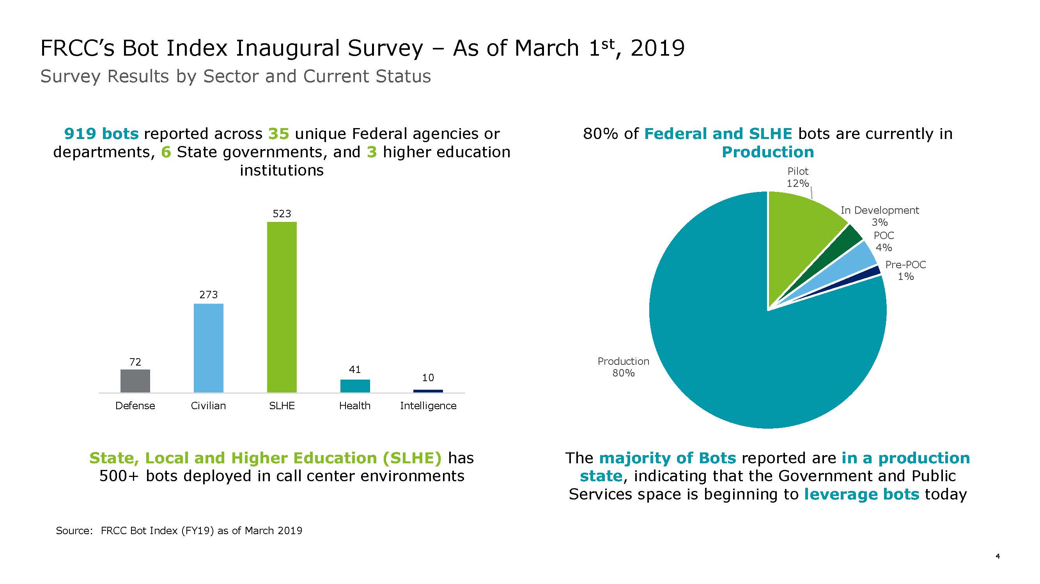
Automation robots, or “bots”, have proliferated in the public sector as agencies quickly accept and leverage this new capability
Notes:
Masked Client Names
Converted Vendor count to % instead of # and eliminated * caveat

Slide 5
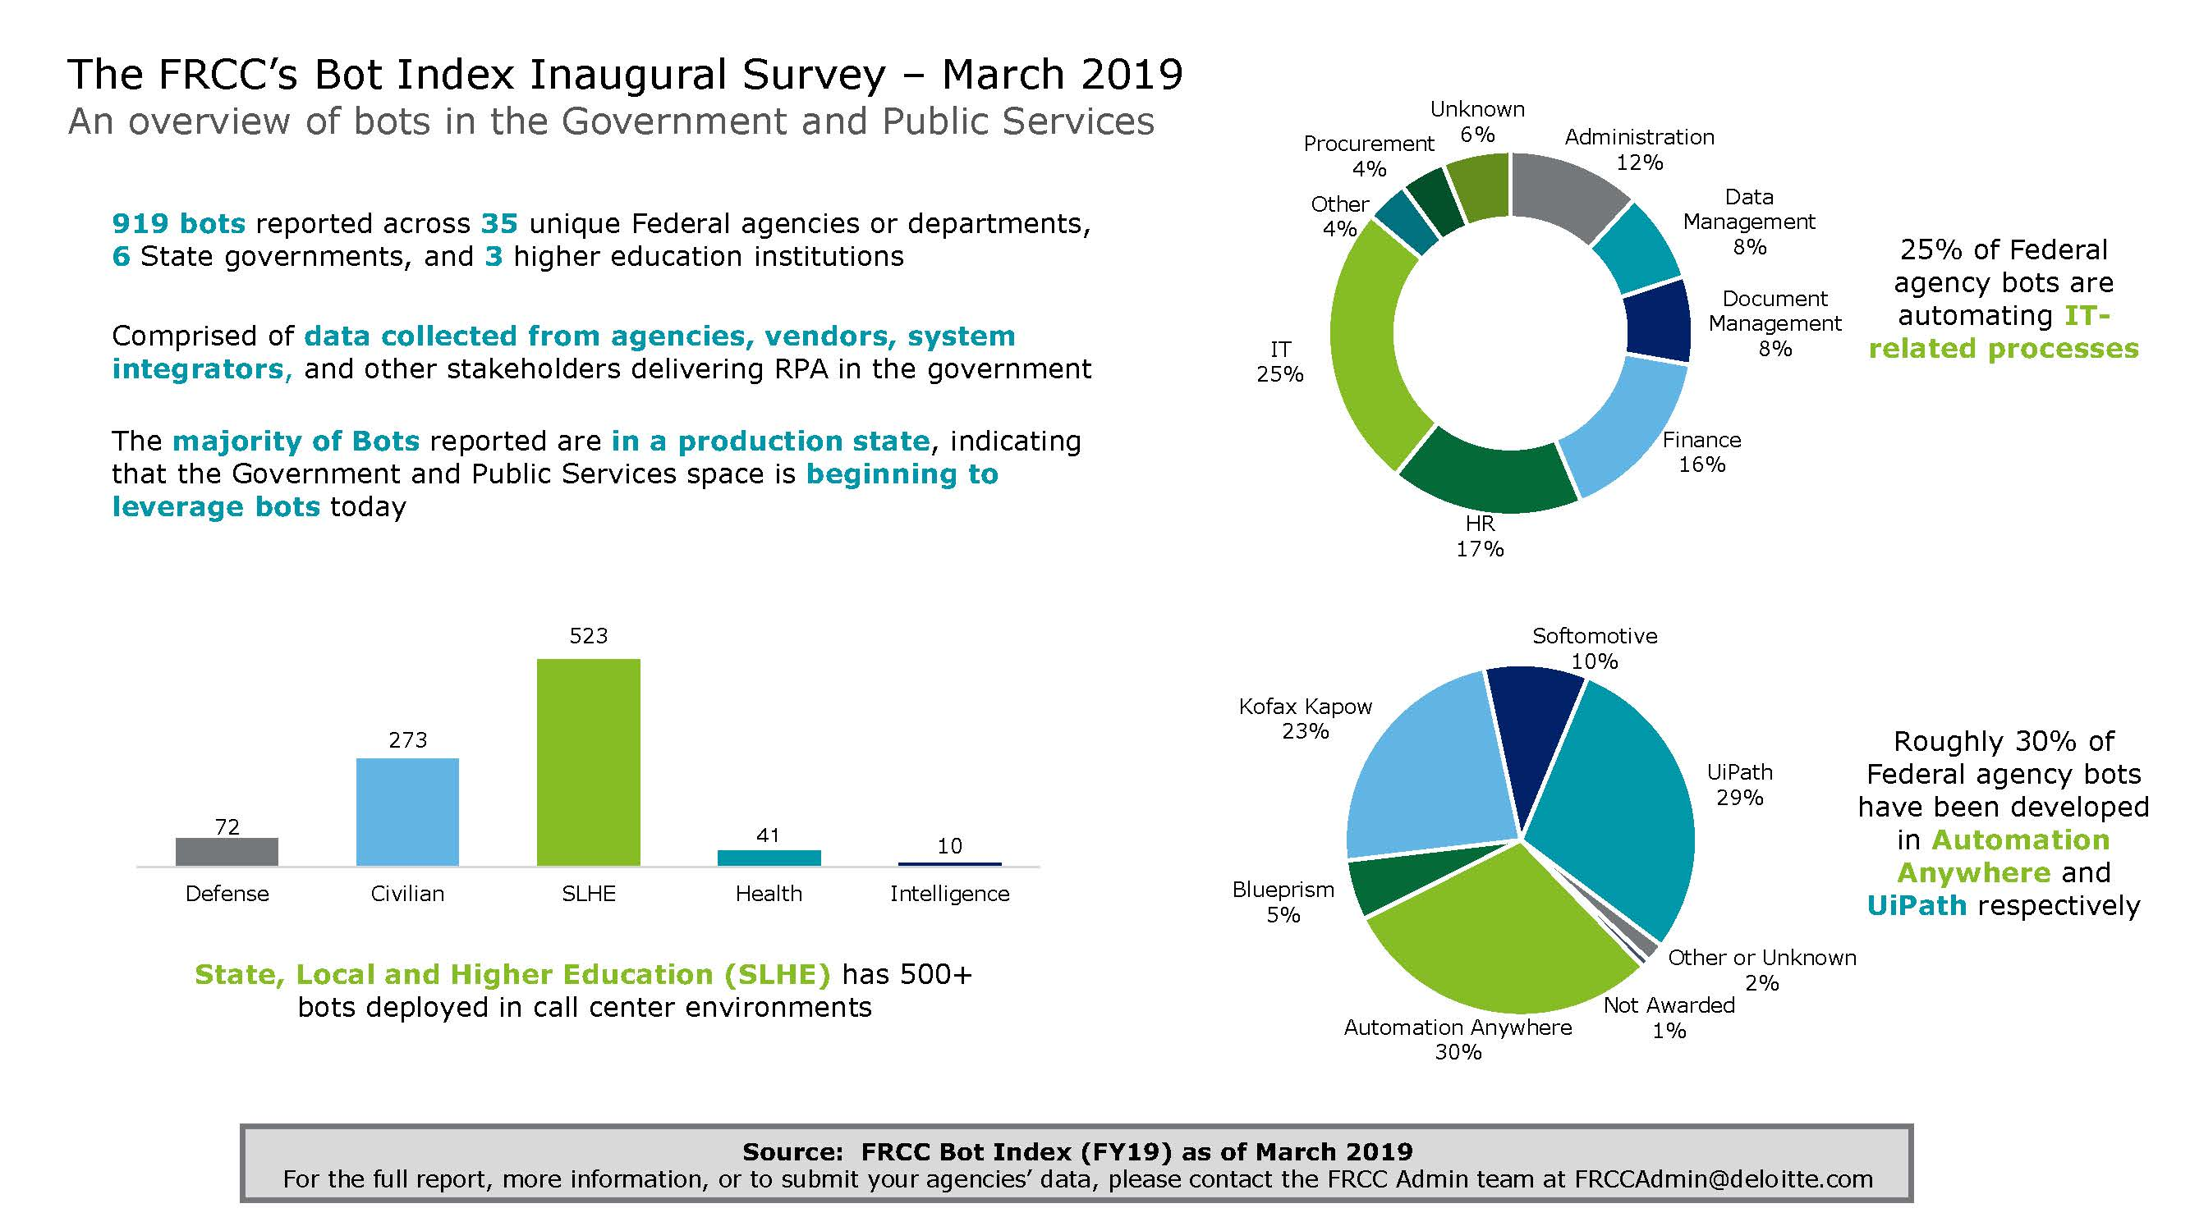
There are a wide variety of agencies and process functions able to take advantage of these new digital labor sources
Notes:
Masked Client Names
Converted Vendor count to % instead of # and eliminated * caveat

Slide 6
Lifecycle of a Bot Project

Slide 7
There are a wide variety of agencies and process functions able to take advantage of these new digital labor sources
Phases
Initiate
Design
Develop
Test
Transfer
Operate
Project Work Plan
Automation Suitability
Process Metrics
Map Process
Future State Process
Governance
Path to Scale
Process Design Documentation
Build Automation
Audit Logs
Test Cases
Documentation
Training Plan
Test Solution
Troubleshoot Errors
Deploy Changes
Refine Business Case
Lessons Learned
Production Testing
Regression Testing
Implementation Plan
Production Automation
Dashboard
O&M
Managed Service
Primary Tasks
Provide advice, guidance and technical evaluations
Stakeholder Engagement
Notes:
Masked Client Names
Converted Vendor count to % instead of # and eliminated * caveat

Slide 8
Scaling Process Robotics

Slide 9
Introduction to Scaling Process Robotics
Many organizations that get started with bots often hit a wall when figuring out how to scale bots appropriately.
Demystifying Scaling. The Facts.
The same level of effort required to standup your first 5-10 bots is not cost efficient for long-term scaling.
The development of the automation is usually the easiest part of the overall process. The additional time needed for the first 5-10 bots is usually tied to extensive reviews, participation of too many stakeholders, and unnecessary documentation.
Formal documentation, review cycles, and people’s involvement should get easier over time.
Faster bot building and deployments will vary with process complexity – but speed should be the goal.

Slide 10
Scaling Bots
The following table discusses the differences between the initial bots your organization develops and what should be used when you truly begin to scale bots.
Process/Document | First 5-10 Bots | Scaling
Process Definition Document | Templates confirmed Detailed reviews Regular updates to POCs Signoffs delayed | Template finalized Process documented in 1-2 business days Review/signoff by Process Lead only Updates pushed to change requests post-deployment
Testing | Detailed test scripts developed Real-time updates to test scripts during UAT Continuous development | Test scripts built as part of the PDD Test scripts/data locked down and signed off during PDD development Updates pushed to change requests post-deployment
Reviews | Continuous reviews by process leads, leadership, governance boards, IT, and more | Governance board reviews to determine if process is a good automation candidate Reviews by the Process Owner at set points in the development process
Software/Process Authority to Operate (ATO) or Authority to Test (ATT) | ATOs/ATTs required for the robotics software, process, and systems the process touches | ATOs/ATTs not required for every automation Annual review/refresh of the ATO/ATT for audits
IT Environment | Extensive setup required Defined processes on capacity and workload management | IT Environment is established with minimal updates required New processes are deployed quickly

Slide 11
Scaling Roadmap Overview
Five key stages define minimum requirements and additional considerations for an organization as they progress through the scaling roadmap
[Organization] Progress
0
Engage
1 - 5
Pilot
5 - 10
Preparing to Scale
10 - 20
Managed Capability
20 - 50
Scale Across the Enterprise
50+
# of automations*
Identify stakeholders
RPA 101
Roadmap
Technology assessment
Engage IT
Assess and select process(es)
RPA Software
Develop bot(s)
Initial O&M plan for bot(s)
“Enterprise” Solution
RPA Governance
Engage Security and Review Boards
Standard process
Development Approach
Training plan
Finalize hosting
Abridged process documents
Contracts for surge staff
Deploy O&M plan
Workforce Transformation
“Enterprise” Approach
Marketing/ communications
Lessons learned
Track metrics
Introduce new technologies
*The bot range scale is used for reference and may not directly reflect the number of automations deployed.
Notes:
Insert organization name above the star; align the star with the associated progress made at the organization. Show slides for each roadmap category based on the organization’s progress
Potentially add technical set up to the pilot phase and getting more technical feedback, potentially take the the “attended piece”

Slide 12
What should we do next?

Slide 13
Confirm, strengthen, and then transition to scale
As lessons are learned from the first five-to-ten bots, the process for deploying automation within the organization should get easier and more routine
 | Pilot Phase | At Scale
Process Design Documentation | Develop process architecture with outlines for each system and keystroke | Streamlined development PDD developed for scale
Technology Deployment | Approval of software and TRB review Deploy software on single laptops | Rapid technology deployment through selected hosting mechanism
Process Selection | Conduct OMA with initial key stakeholders Select simple process to prove out capability | Self selection and submission to RPA oversight committee Continuous process intake and assessment
Automation Development | Select pilot or pilots to develop initially Development concludes with testing and business case construction for future automations | Automations are developed on a continuous basis using agile methodology
Notes:
We don’t want to overcook this but we want to give them an idea of where they are in the journey
Everything you’ve learned about RPA → you have to change that thinking to get to scale (PDDs have to get simpler, processes need to be streamlined) are you really ready to scale.
So potentially have a two column table (Full PDD → steamlined PDD). Potentially could have a word cloud at the end with the big points

Slide 14
What should you do… now!
If you haven’t started… | If you have started…
Breathe… Take one step at a time Start small… Pick a process… Pick a vendor… Kickoff a pilot… | Pat yourself on the back… Evaluate your pilot… Review your technical setup… Begin thinking about governance… Setup a Center of Excellence…
And don’t forget…
Focus on customers, especially the user experience
Don’t over-promise
Show, don’t tell
Reassure your people
Notes:
We don’t want to overcook this but we want to give them an idea of where they are in the journey
Everything you’ve learned about RPA → you have to change that thinking to get to scale (PDDs have to get simpler, processes need to be streamlined) are you really ready to scale.
So potentially have a two column table (Full PDD → steamlined PDD). Potentially could have a word cloud at the end with the big points

