Slide 1
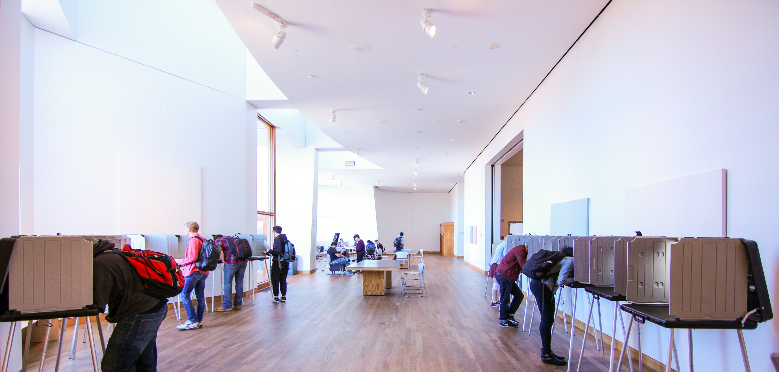
Minnesota
Presidential Nomination Primary
Election Judge Training
Notes:
Talking Points:
The Minnesota Presidential Nomination Primary was authorized by the legislation in 2016.
For simplicity, we will use the term “presidential primary” throughout this training presentation.
The following are guideline slides, you may adapt as needed.
We recommend giving head judges additional talking points about higher level questions from voters/tips for de-escalating PNP related concerns being expressed in the polling place.
Please note that we included slides for use of both electronic and paper rosters, only use what is applicable to your precincts.

Slide 2
What is the Presidential Primary?
Minnesotans will nominate major political party presidential candidates by voting in a primary election on March 3rd
Previously this was done through the caucus system
The major parties will still hold caucuses on February 25th - in order to discuss and vote on other issues
Switching from caucuses to a presidential primary was a legislative decision in 2016.
Notes:
Talking Points:
While voting in a Presidential Primary is a change for voters across Minnesota, rest assured that as election judges, the Election Day processes that you are familiar with are largely the same.
The polling place processes that have changed are to accommodate for voter privacy as they choose which party’s ballot to vote.
This was not a decision made by the parties or made by election officials. On this primary day, it’s important that election judges continue to maintain professionalism and adhere to the election judge oath taken at the beginning of the day.
Have you heard of Super Tuesday? It’s a day when 15 states and territories hold their presidential primaries, and we are now one of them.

Slide 3
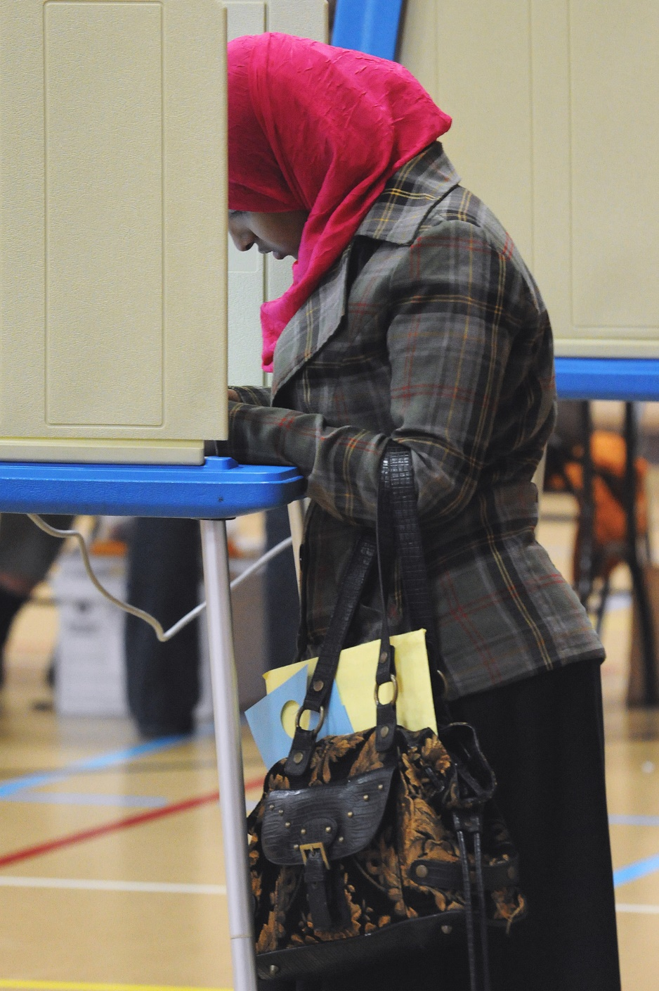
How will the Presidential Primary work?
Voters will request a major political party’s ballot & only receive that ballot to vote
Ballots will only have the candidates from that party
In 2020 Minnesota has four major political parties:
  Legal Marijuana Now*
  Grassroots-Legalize Cannabis*
  Republican
  Democratic-Farmer-Labor
Notes:
Talking Points:
It is the each major party’s decision to participate in the presidential primary, the candidate names they choose to list on the ballot and/or the items they wish to include (i.e., write-in or uncommitted).
Only two Minnesota major parties have notified the OSS that they are participating in the PNP: Republican and Democratic-Farmer-Labor.
The two, newer major parties have declined participation in the PNP but maintain their major party status in our state.
The two, newer major parties achieved major party status in our state after the 2018 elections.

Slide 4

Voter Privacy
Only the following voter data will be provided to the chairs of the major political parties:
Name
Address
Voting districts
Year of birth
Major party ballot choice
***Which candidate the voter selects remains secret***
Notes:
Talking Points:
Voter privacy is our top priority.
Voters have voiced concerns about their data being shared, and we expect you to continue to hear those concerns in the polling place.
We want voters to feel comfortable in the polling place, and we do that by being transparent about who will receive their information.
All four major party chairs will receive the list of those who voted in the presidential primary.
Parties that receive this information are only allowed to use it for political and election purposes (purposes allowed by current laws).
Do discuss with election judges the ramifications (both criminal and civil) if a “data breach” of a person’s major party ballot choice is made before, during, or after the primary election day.
It is a very serious conversation to have and it is outlined in both the PNP admin guide and the PNP EJ supplemental guide.

Slide 5

Talking to Voters about the Presidential Primary
Please be patient with unhappy voters, often they are simply confused by the process.
Have some go-to customer service responses ready:
“We can’t discuss opinions about this Primary, but perhaps we can answer any procedural questions you may have.”
“Here is a feedback form where you can express your concerns about the primary process. It will be sent to our elections admin office for review.”
Notes:
Teaching soft skills to election judges is a good time to insert group discussion and activities. Consider having them discuss in groups their own examples of how they would calm down a worried person or how they have de-escalated a situation with an angry voter in the past.
If your jurisdiction hasn’t traditionally passed out “feedback” forms to voters in the poll place, we suggest that the presidential primary might be a good election to have such a form (?). This will give voters a chance to express their thoughts and feelings about this primary without having to complete a complaint. The returned feedback forms could be used to provide valuable feedback to legislators if they should happen to ask for city/town/county input in the future about this primary?
Talking Points:
Level with the voter by saying something like, “Like you, voter privacy and election security are our top priorities. This system was designed with you in mind, and if you can think of any improvements, I would be happy to give you the appropriate feedback form to fill out.”
If you are dealing with a voter who clearly isn’t going to stop talking, let them talk. Often they just want to feel heard, and your body language and facial expressions can promote those positive feelings. Relaxing facial muscles, nodding and moving slowly to stand alongside an upset person goes along way to de-escalate feelings of anger.
Remember, if a voter is angry at you, it is not your fault and it is not your job to convince them not to be. You are simply doing your job by administering this election, and they may complain through the appropriate channels, such as talking to their legislator, if they wish.

Slide 6
Overview of Polling Place Changes
To accommodate for multiple ballot styles & the privacy of a voter’s ballot choice, some polling place procedural adjustments are suggested
These suggested changes impact the following stations:
  Greeter
  Poll book/Check-in/Roster
  Demonstration
  Ballot
Notes:
Talking Points:
These process changes were made with voter privacy in mind, as well as ease of process for election judges.
If you’re ever confused about these changes, your first line of support is your head judge.
The clerk/election administrator of your city or town should be contacted immediately if anything of a serious or emergency nature arises.

Slide 7
Greeter Station
Because the greeter judge is the first person voters meet:
You can expect questions about the presidential primary process, as well as complaints
You should be prepared to show & explain several posted sample ballots, as well as look at the prepared answers provided for common questions and concerns
Notes:
Talking Points:
We do ask that all election judges provide extra patience and understanding for voters with this new primary process, all election officials must keep decorum in the polling place and keep the safety of voters in mind.
Locate FAQ sheets and complaint forms early in the day so that you can provide them when necessary.
Always refer to your head judge if you feel a voter is becoming more and more upset. That little bit of a waiting period sometimes de-escalates a situation.
If a head judge needs to call the clerk for assistance, please do so. Sometimes having a voter talk to the clerk on the phone or having the clerk come to the polling place (especially if they are in the same building) helps the situation de-escalate as well.
We suggest supplying your greeter station supply bag (if applicable) with additional PNP FAQ and answer sheets.

Slide 8
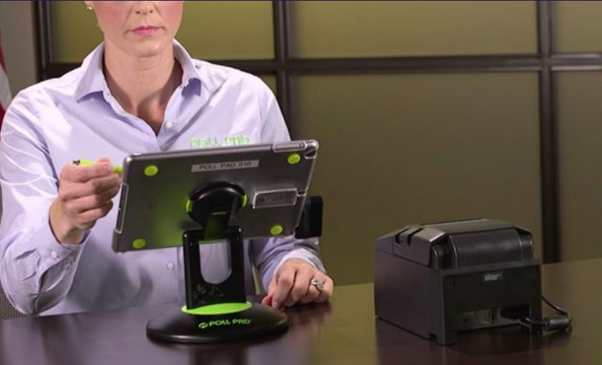
Poll Book Station – Checking in Pre-Registered Voters
After confirming the name & address of a pre-registered voter on the poll book screen, you will turn the screen around to allow them to select their party ballot choice before checking them in
You will then give them a “party-noted” voter receipt
If a voter refuses to select a party, they will not be able to vote
Notes:
Talking Points:
Always being discreet; not sharing party choices in ways that others may easily learn of another’s choice
Unless necessary for communication with a voter, please do not say “out loud” which party a voter selected.
This seems like an easy request, but you may find yourself wanting to say something along the lines of “Republican was your choice, correct?” Please avoid this.
Instead of verbally confirming party choice with voters, show voters their receipt and ask them to confirm that the party choice that is noted.
Don’t have different color voter receipts for the different parties.
Keep stacks of voter receipts in a slightly obscured location, such as in a folder, bin, or face down on a spindle.

Slide 9
Poll Book Station – Election Day Registrations
Early in the registration process, a voter will select their party choice on the screen. They will have an opportunity to confirm that they selected the correct party at the end of the registration process
Same day registrants will also receive a voter receipt with their party selection on it

Slide 10
Roster Station
The challenge info & party ballot choice of other voters is concealed
Consider keeping the roster binders closed when not in use, or using a sliding privacy protector so voters can only see their own information
Keep voter receipts discreet because they list the voter’s party choice
If a voter refuses to select a party, they will not be able to vote

Slide 11
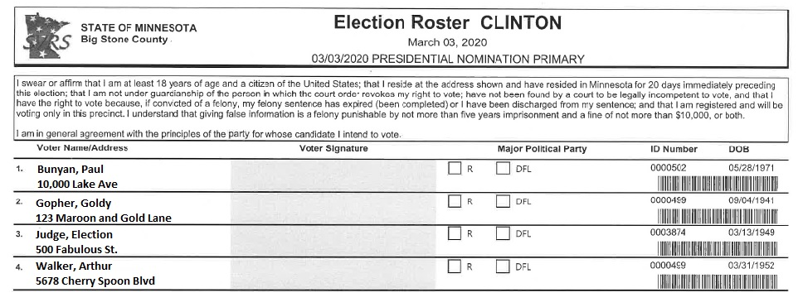
Roster Station

Slide 12
Registration Station
The voter registration application will not include the party ballot choice
The voter will choose their party ballot choice on the EDR roster page
The party ballot choice of voters must be covered from the view of other voters
Binders are turned away and/or closed when not in use
Keep the party ballot choice as discreet as possible on the voter receipt

Slide 13
Demonstration Station
Use the same generic demonstration ballot for all party ballot choices
Explain that each ballot will only have candidates for the indicated party
Explain that the only race is for the presidential nomination
Notes:
There are responses in the PNP EJ Supplemental Guide that can be used by Election Judges to answer these questions about write-in spaces and/or the candidate choice of “uncommitted.” Or training officials may provide their preferred responses.

Slide 14
Ballot Station
Ballots must be prepared for each party, it is your head judge’s discretion how many ballots to prepare in the morning.
Once a voter has received their ballot, they cannot change their party choice. This means:
  If the voter changes their party choice between the check-in station and the ballot station, they can go back to the check in station and update their record to receive the appropriate ballot.
Notes:
Talking Points:
Look for ways to obscure ballots from view so that a voter’s party ballot choice cannot be easily determined by others in the polling place. Perhaps use a skirted table, or keep them on a lower table or chair beside the station, rather than in piles easily identified by others.

Slide 15
Ballot Station
All voter receipts, no matter the party, can be counted & bundled together
All spoiled ballots go into the same spoiled ballot envelope
When replacing spoiled ballots, ensure you are giving the voter a ballot from the same party

Slide 16
Head Judges
  Review provided materials before Election Day
  You may have to answer more questions this year than usual
  Focus on de-escalating techniques & listening to a voter if they are concerned about the change of process
    often they just want to feel heard
  Don’t be shy about handing out feedback forms!
Notes:
Talking Points:
In the morning, Make sure zeros tape matches all ballot styles’ candidates & rotations
During your hourly audit and closing, your ballot styles do not effect your numbers. i.e. You count and track voter receipts and the public count on the tabulator the same way as usual, all the ballots are counted as one unit.
Things to consider as head judges:
How many ballots for each party should I prepare? While we may understand the political demographic of our precincts, we also shouldn’t make assumptions and find ourselves unprepared or accused of bias. On the other hand, if you prepare the same number of each type of ballot, you may be unnecessarily using up valuable opening time. As for all elections, we trust your judgement about how many ballots to prepare before opening.
Remember, this is new for all of us! Be extra patient with your judges and voters as we navigate this Election Day together.

Slide 17
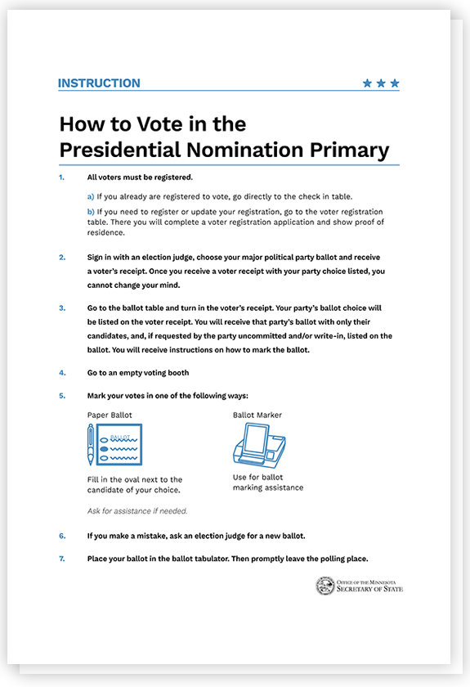
Posters
Additional posters with primary information
Sample ballots for all parties
Voting Equipment
There will be more than one ballot style for every precinct
Both the ballot tabulator & the assistive ballot marking device will be able to handle all ballot styles in your precinct
Notes:
Talking Points:
In order to keep voters’ party choice private, you may need to use additional folders, screens and/or storage containers to keep ballots and voter receipts away from the view of others

Slide 18
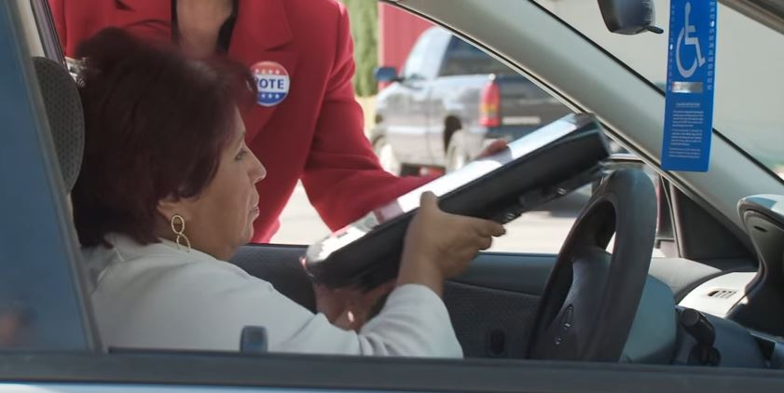
\
Curbside Voting
Have a set of sample ballots available for curbside voting
Use PNP Voter Certificate (PNP EJ Supplemental Guide Appendix)
Voter marks party choice
Deliver only ballot marked on receipt

Slide 19
\
Notes:
Top half of the PNP curbside voting certificate of registered voter form, note the party selection in the bottom right hand corner.

Slide 20
Accessibility
Be mindful of the privacy of voters who may not be able to select their party on the poll book screen or mark it on the roster.
Offer them the option to:
  Indicate their party choice in another nonverbal way
  Verbally state their party choice in a way that is as private as possible
Notes:
Other ways a voter could indicate their party choice:
Pointing at sample ballots
Stepping away from other voters so they can tell you in private
Having assistance from a voter assistant to select, indicate, or write their choice.
Talking points:
When assisting a voter with navigating the polling place, or in determining which party they wish to vote for, never assume how much help a voter needs. Follow the voter’s lead.

Slide 21
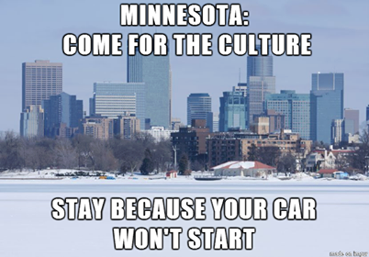
Accessibility
Because this is a March election, we need to be mindful of winter weather creating hazards affecting the accessibility of the polling place
Contact the elections office if the sidewalks & parking lots become difficult to navigate

Slide 22
Challengers
There are no changes in the rules for Challengers:
  Even so, keep in mind:
    Challengers may not challenge a voter’s party choice
    Challengers may not document who is voting for what party
Complaints
State Election Law & HAVA complaint forms are supplied for voters to file a complaint

Slide 23
FAQs
Why is there also a primary in August?
The August 11th Primary Election has state-wide offices on it.
Why are there still caucuses?
The parties will discuss and vote on other issues at their caucuses on February 25th.
If they are turning 18 by the General Election on November 3rd, can a 17 year old vote in the Primary Election?
No, in Minnesota you must be at least 18 years old on Election Day to vote.
Notes:
Will all of the parties and their candidates be on the same ballot?
No. You must request the ballot of one major party, and you must be in general agreement with their principles.
Who will know which party’s ballot I request?
The ballot which voters select is information that will only be provided to the chair of each major political party. Party chairs may only use the list for political & campaign purposes. As in every election, who you vote for will remain secret.
Why aren’t all of my party’s candidates on this ballot?
The state parties determine who is on their ballot.
And more fun questions

Slide 24
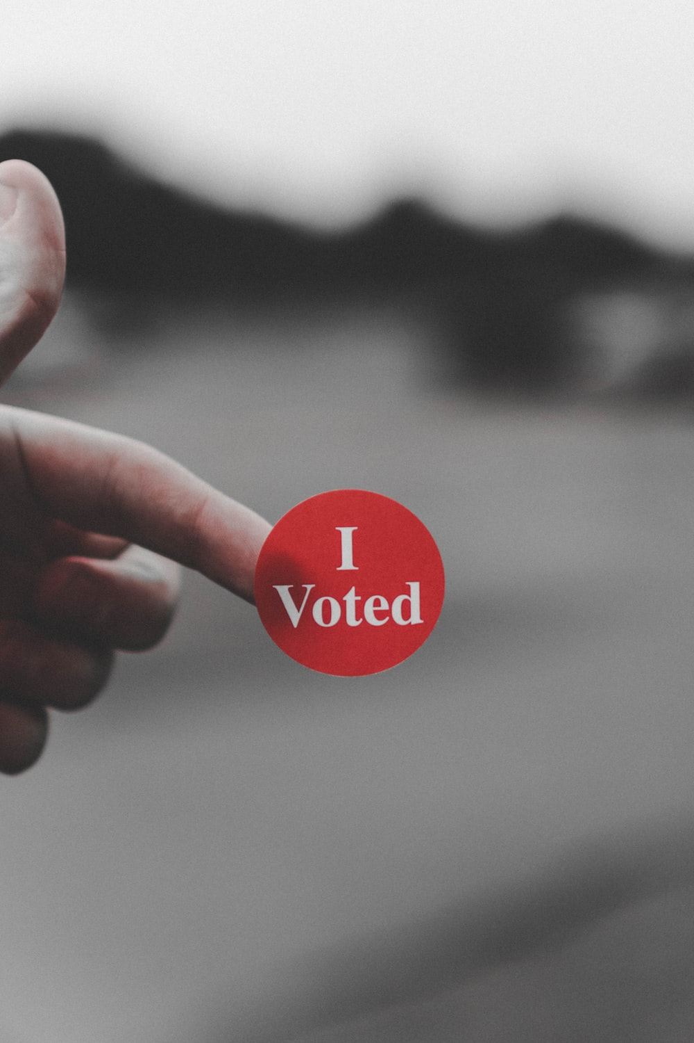
Discussion
Notes:
Talking points:
Don’t forget to vote early if you work outside of the precinct where you live.

