Slide 1
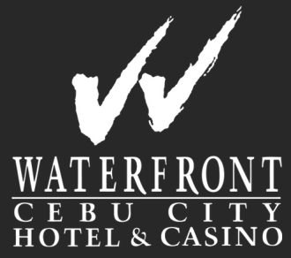
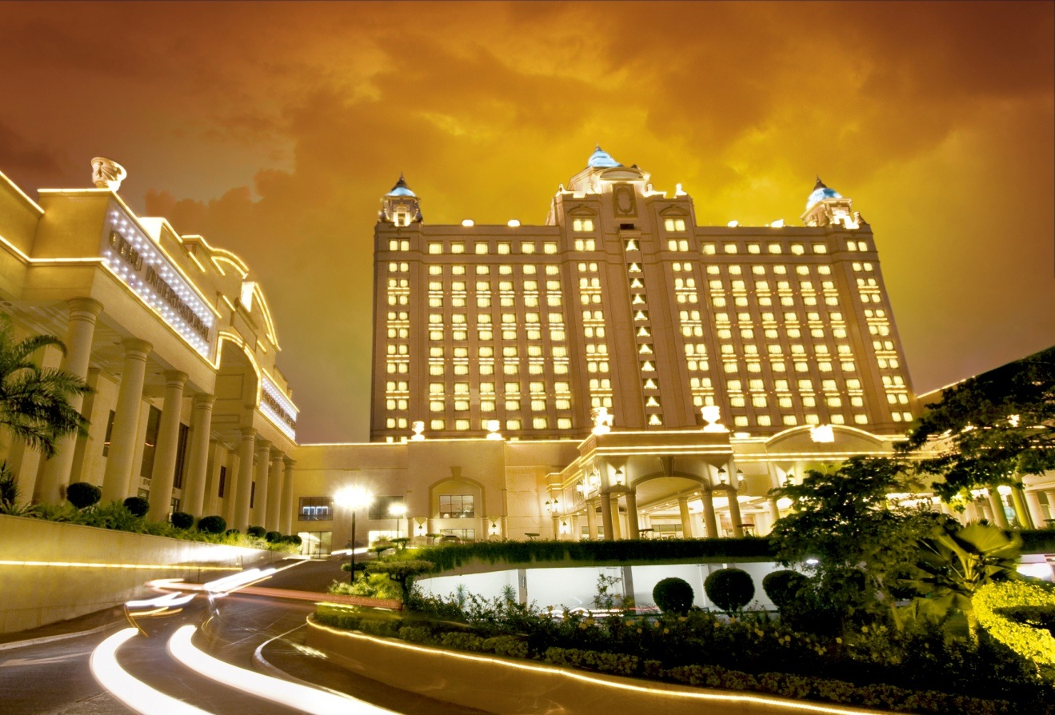
Waterfront Cebu City Hotel & Casino
HOTEL ORIENTATO

Slide 2
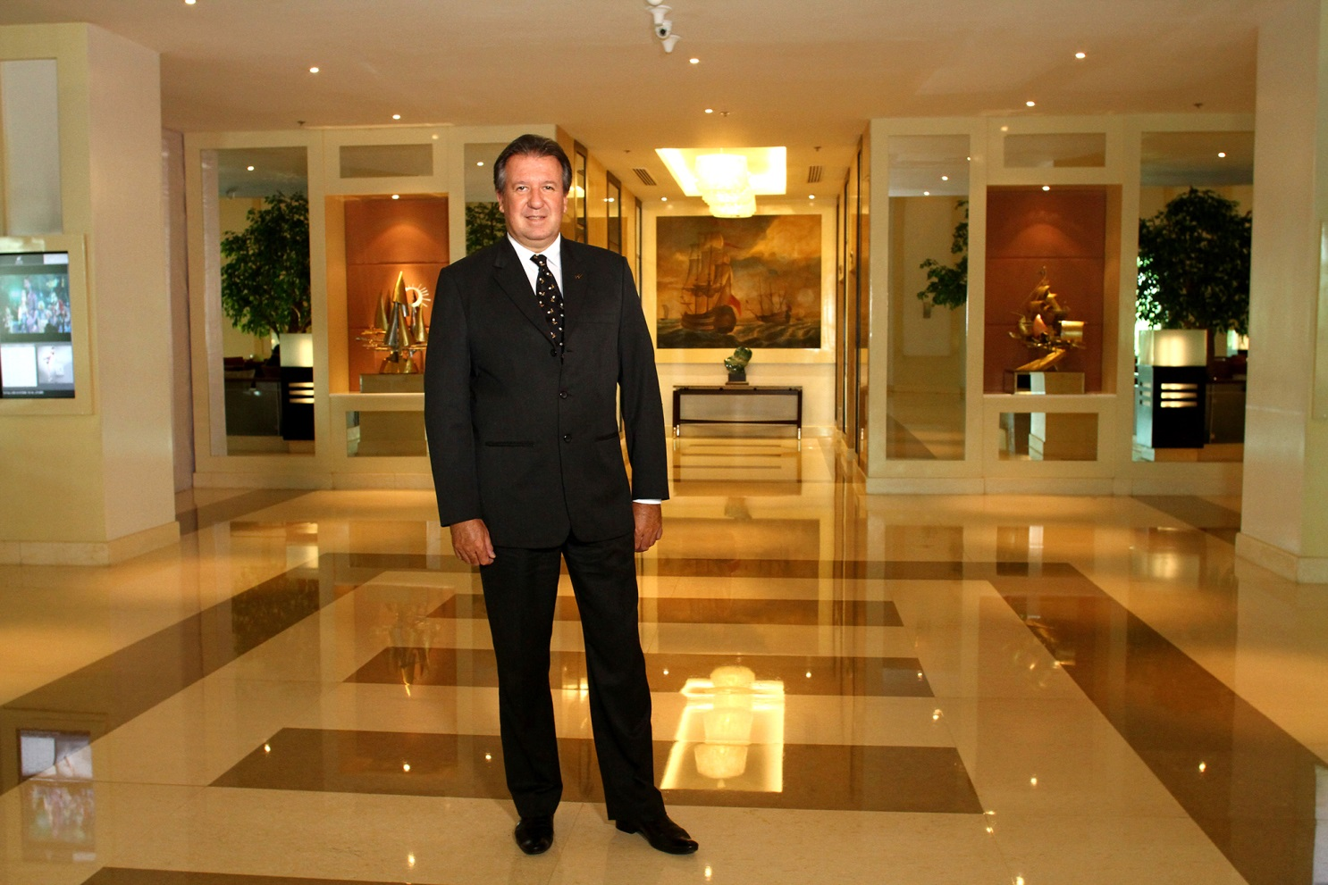
General Manager Philippe F. Frugère
HOTEL ORIENTATO

Slide 3
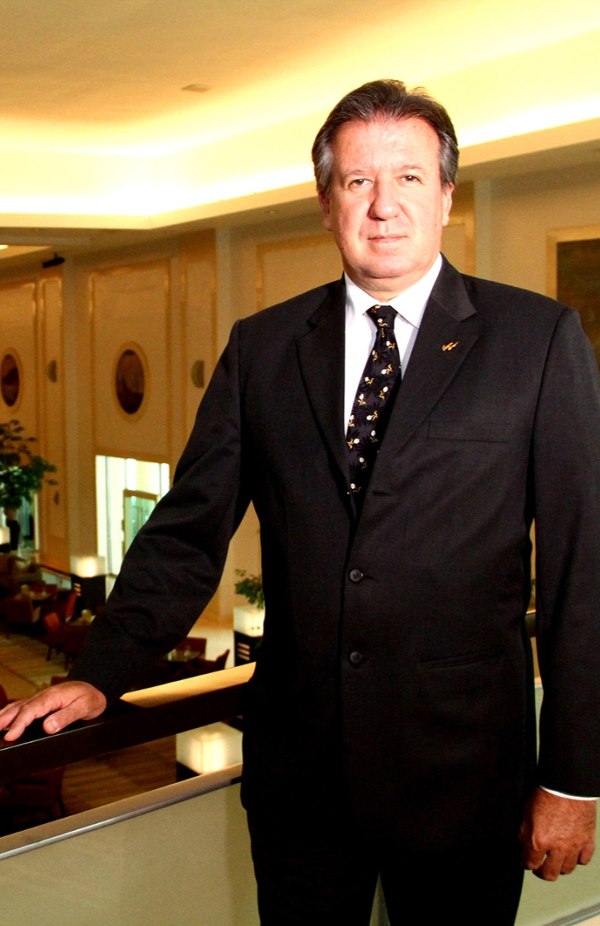
IDENTIFICATION
Philippe F. Frugère
General Manager
Waterfront Cebu City Hotel & Casino
1 Salinas Drive, Lahug
Cebu City, Philippines
Waterfont Hotels & Casinos

Slide 4
CAREER
What result(s) in recent years are you the most proud of?
I’m quite proud of the developments of the hotels I’ve handled before and I am confident to bring the same improvements and the possibility for Waterfront to be internationally recognized as at par with other world-class hotels around the world through international awards and accolades.

Slide 5
CAREER
In the future, what are your objectives concerning both your personal career and the development of your hotel?
In my personal career, I would like to get back the position as Group General Manager which I held prior to joining Waterfront Hotels & Casinos group. Once I have achieved that, I hope to become the CEO of the Hotel Group.
To further develop the hotel, I intend to increase the GOP, Turnover, EBITDA, Occupancy, ARR, and RevPar figures of the hotel. I would also like to position the hotel as the first in its category in the region amidst the stiff competition in the hospitality industry.
This shall be achieve through partnership with OTA (Online Travel Agencies); and through innovative technological solutions such as Mobile App bookings, and online bookings.

Slide 6
CAREER
Describe your management style
I have a very hands-on management style.
In terms of leadership, I create a team that has an osmosis (or a team that works as one) to achieve the goals for the Hotel.
I also foster out of the box thinking in terms of generating creative ideas, promotions, sales packages and in dealing with concerns & problems of the organization.

Slide 7
CAREER
Through my leadership and management, I have garnered the following awards & recognition for the different properties I have handled:
Winner "Maldives' Leading Beach Resort" 2013. Voted by "Matato Maldives Travel Awards"
Third Best Hotel General Manager 2013 for Luxury category. Voted by "Worldwide Hospitality Awards"
Trip Advisor Award winner Certificate of excellence 2013.
Best Middle East independent Spa Award 2012 – MESPA Awards
Pan Arab Oman Bronze Web Award 2010 & 2011
Voted Oman Green Award 2010 – An OER Initiative

Slide 8
CAREER
World Travel Awards winner for Maldives’ Leading Resort 2010
First Resort to be certified Silver Green Globe / Earth Check in 2010 within the Maldives
Bronze Green Globe certification in 2008, 2009 and 2010
Hotel of the Year Award in 2006 – 2007
Special commendation for People & Quality performance
First in Southern Hemisphere to be certified ISO 9001-9002, ISO 22OOO, ISO 14000

Slide 9
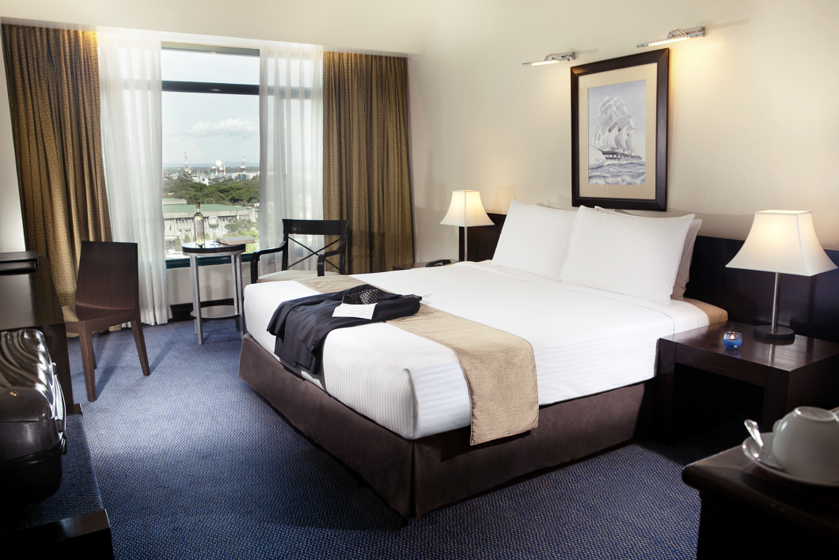
HOTEL DESCRIPTION
Category: 4 Star
Capacity: 561 rooms
Distribution of Rooms:
160 Standard
157 Superior room
143 Deluxe room
16 Junior Suite
30 Executive Suite
13 Ambassador room
10 Ambassador Suite
3 Bridal Suite
4 Family Suite
2 Presidential Suite
1 Penthouse
Restaurants:
UNO, Mizu, La Gondola, Tin Gow, Lobby Lounge, Café Fortuna, Madeleine, Pool Aquarius, Powerhouse, Treff Bar
Notes:
Brief history of the company and milestones
Date opened
Milestone events (renovation, historical events)

Slide 10
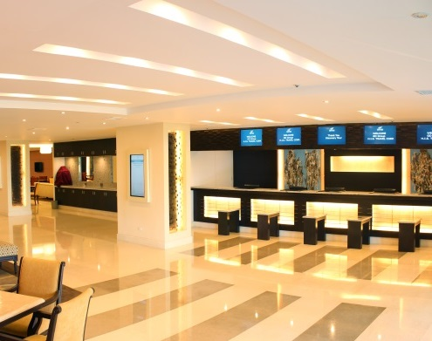
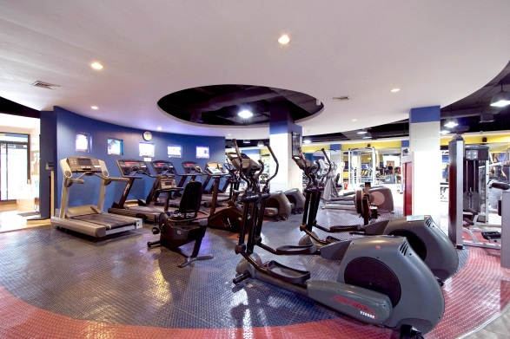
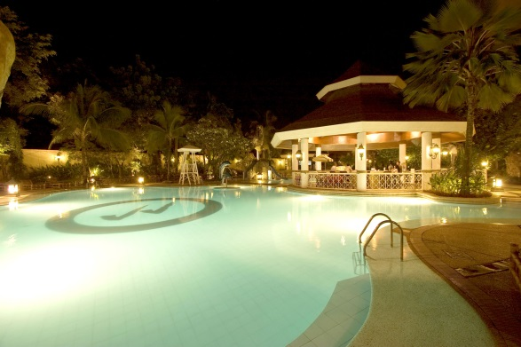
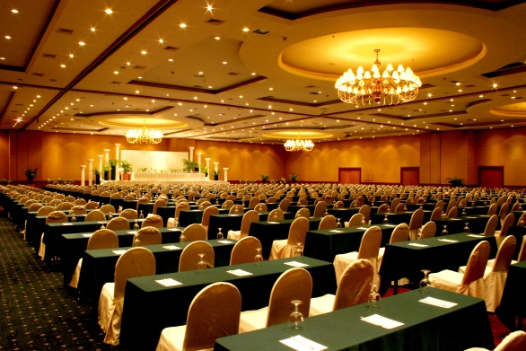
HOTEL DESCRIPTION
Other Facilities:
- 24 hour Casino
- 24 hour Gym with Steam Room and Sauna
- Massage Center
- Swimming Pool
- Multi-level Indoor Parking
- Groups and Convention Check-in/Check-out Lounge
- Convention Center (17 function rooms, 2 Grand ballrooms; seating capacity of up to 4,000)
Notes:
Brief history of the company and milestones
Date opened
Milestone events (renovation, historical events)

Slide 11
HOTEL DESCRIPTION
 | 2011 | 2012 | 2013
Occupancy | 64% | 58% | 51%
Average Daily Rate | 2,153 | 2,275 | 2,356
RevPAR | 1,367 | 1,313 | 1,203

Slide 12
CUSTOMER SATISFACTION
Quality Control Programs in the Hotel
- Internal Audits (conducted by the Skills and Operations Team, and Corporate Internal Audit Department)
- External Audits (Mystery Shopper)
- Food Safety Program (for F&B)
Peers Training Dept. also conducts validation for the skills and knowledge of our Hotel peers.
Percentage of overall customer satisfaction
Latest available data (July 2014) presents the overall customer satisfaction at 77%. GSI Rating is 4.47 (out of 5), a mid-good rating, which indicates that the Hotel has mostly complied with the standards and requirements for guest satisfaction.

Slide 13
CUSTOMER SATISFACTION
What is your personal implication in this quality process?
In order to reach and exceed guests’ expectations of the overall hotel experience, it is important to lead the team in a way that would achieve the best results in our Guest Satisfaction Index. The aim is to increase the target every year and actually reach these targets.
 | 2011 | 2012 | 2013 | Growth Rate (2011 – 2013)
Overall Hotel Experience (Rooms, F&B, Banquet) | 4.24 | 4.41 | 4.5 | 6.1%

Slide 14
STAFF MANAGEMENT
What are the tools for staff training?
The hotel invests heavily on its “Peers” or what we call our staff. We have the following training programs that further develop our Peers:
1. In-house trainings:
- Inductive
- Basic Skills
- Upgraded Skills
- Leadership & Management
- Wellness
All training programs have knowledge exams and some have skills exam.
2. External Training Programs
These external training programs depend on the skills enhancement and Developmental Action Plan of each
employees.

Slide 15
STAFF MANAGEMENT
What tools and actions to develop the motivation and employee satisfaction?
• Send key personnel to external training programs
• Exposure Trips abroad to experience industry best practices
• Peers Services Department Activities: Special Events like Sports Fest, Christmas Party, Ticket Concerts for Raffle, Health & Wellness Projects

Slide 16
STAFF MANAGEMENT
Can you summarize your view of management teams?
Everything should start at the base of the organizational pyramid or team. Cascading the information from the team members to the top management is a must and should be done with a certain chemistry among the departments and the overall organization.
The secret to managing a hotel is to get the people to trust and believe in you as a leader and a visionary. You should always be aware that you must be available – to understand your team members from their point of view, on their level to fully understand their concerns.
Without the team’s cooperation, a General Manager, cannot achieve anything but with a good team, anything is possible.

Slide 17
MARKETING & COMMUNICATION
Our goal for marketing is to be the top-of-mind hotel in the region. We continue to host our much celebrated events that we have been known for such as our Christmas Tree Lighting, New Year’s Eve Party, Chinese New Year celebration, and Easter Celebration.
We have always been visible in traditional media through print, radio, and TV advertisements on the national and local level. We have also maintained good working relationships with the media
Likewise, we have also been aggressive in our online and social media marketing by revamping our website, being active in social media, and tapped local and international bloggers to feature the hotel.
To adapt to the times, we have also launched the Waterfront Mobile App that is available on Android and iOs devices which features our F&B promotions and Room promotions, while guests can directly book their stays through our mobile app.

Slide 18
MARKETING & COMMUNICATION
Do you participate in the local or national community life, and how?
The Hotel is a landmark in Cebu City and the region that is a host to the social events of local society. We want the local population to visit us not just for business but through our significant social events in the hotel.
To support the Local Tourism Industry:
The Hotel conducts trainings with Technical Education and Skills Development Authority (TESDA),
The hotel has an internship program of hospitality & tourism students from local universities to be exposed to the industry;
The Hotel received a grant from the DOT to contribute to the local tourism industry
The Hotel has future plans of partnering with Children of Asia, an international non-profit organization that provide feeding & education for underprivileged children in Cebu

Slide 19
MARKETING & COMMUNICATION
The hotel is a member of the following professional associations:
1. The Hotel and Restaurant Association of the Philippines (HRAP) is the umbrella organization of hotels and restaurant that speaks for the Philippine hospitality industry.
2. The Hotel, Resort & Restaurant Association of Cebu (HRRAC) is a non-profit, non-government organization of the Hospitality Industry (Rooms & Food and Beverage) that have bonded to promote professionalism, in the hospitality industry.
3. The Chaine des Rotisseurs is the oldest and most prestigious international gastronomic society devoted to the promotion of fine dining and the camaraderie and pleasures of the table. In the Philippines there are nearly a hundred and thirty members in two Bailliages in Manila and Cebu.
4. The Ordre Mondial des Gourmets Dégustateurs is a special section of the Chaîne, whose objectives are the promotion of good wines, brandy, liqueurs, spirits, and to get them appreciated throughout the world.

